Slide 1
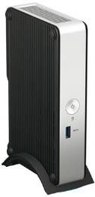
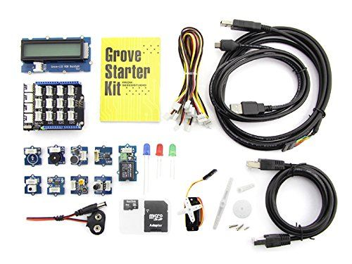
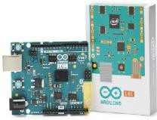

Predix Developer Kit
 | Intel® NUC Kit DE3815TYKE
Dimensions | 7.48" x 4.56" x 1.57"
Processor | Intel® Atom™ processor E3815 (512KB Cache, 1.46 GHz)
Graphics | Intel® HD Graphics (up to 400 MHz)
Storage | Internal support for 2.5-inch HDD or SSD · Built-in 4 GB eMMC device
Expansion | Up to 8 GB of 1333/1600 MHz DDR3L memory via SO-DIMM slot · Half-length mini PCIe* slot
I/O | USB 3.0 port · Five USB 2.0 ports (2 back, 3 internal) · HDMI* port · VGA port · Embedded DisplayPort · Headphone/microphone jack · Intel® Gigabit LAN
+
+
+
Intel® IoT Gateway Software Suite
Predix Machine Version 17.1
Edge to Cloud Integration
Arduino 101/ Genuino 101
Intel® NUC
Grove Sensor Kit
Sensors:
Grove – Button
Grove – Sound Sensor v1.2
Grove – Touch Sensor
Grove – Light Sensor v1.2
Grove – Temperature Sensor v1.1
Grove – Rotary Angle Sensor(p)
Grove – Piezo Vibration Sensor
Predix Developer Kit
Actuators:
Grove – LCD RGB Backlight
Grove – Buzzer
Grove – Red LED
Grove – Green LED
Grove – Blue LED
Gear Stepper Motor with Driver
Others:
Grove Base Shield v2
(14) 26AWG Grove Cables
B to A Type USB Cable – 0.5m

